Slide 1
REZEO
Go-to-Market Proposal
Discussion Materials
September 2023

Slide 2





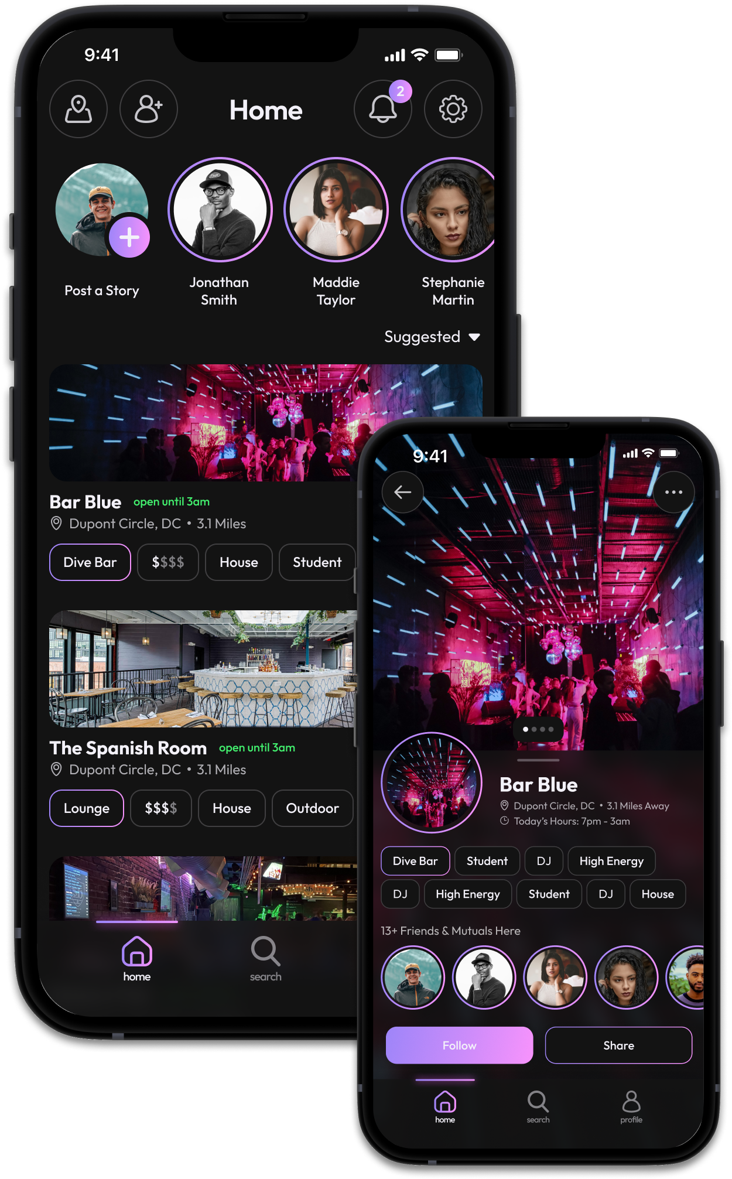


Introduction
 |  |  |  |  |  |  |  | Introduction
 |  |  |  |  |  |  |  | Problem Statement
 |  |  |  |  |  |  |  | Solution
 |  |  |  |  |  |  |  | Project Objectives
 |  |  |  |  |  |  |  | Recommended Process
Daniel Cole
Penn State B.A.- Political Science
Former: Co-Founder, Business Lead
@ Nightspot Technologies
daniel.p.cole1@gmail.com
703.973.5462
Familiarity with Rezeo’s Model via Nightspot
B2B offering to venues & B2C offering to bar-goers
Pre-Seed funded; Johns Hopkins “Spark” accelerator
Grew team to 12 high-contributing members
10+ venues onboarded
~ 1,000 target market (21-29) waitlist signups

Slide 3
Rezeo’s Growth Challenge
How does Rezeo reach “Critical Mass”?
Tipping Point
Social dynamics institutionalize change
Assumptions & Considerations
College Campus Tailwinds
Rezeo’s business model requires candidate/user growth to provide B2B value
Rezeo monetizes through candidate acquisition & engagement
Rezeo must push towards the tipping point
Today, Rezeo considers the tipping point to be 1000 new/organic users per month
Interconnectedness / isolation fosters word-of-mouth and organic growth
Campus culture – willingness to early adopt innovation
Association with higher education instantly boosts credibility & brand image
No other demographics offer such predictable, stable markets (i.e., behaviors, ages, locations)

Slide 4


Power / Performance Gears
Solution:
Small Storm before a Big Tornado
Start by carving out a SMALL niche
Job Seeking Candidates
Enlistment
Acquisition
Active Seeking Gen Z
Adoption is social. People do what they see other people doing.
College Educated
Entry Level / Internship
Monetization
Engagement
General Business Industry
Analysts, Sales, Marketing, etc.
Net Premotor/Power Score: |  | 9-10 | 7-8 | <6
High-Level KPI’s:
Enlistment |  | Positive Virality |  | Churn
Engagement |  | High conversion rates |  | Low conversion rates
Acquisition |  | > 1000 new users / month |  | < 1000 new users/ month
Monetization |  | Low Cost-per-Acquisition |  | High Cost-per-Acquisition

Slide 5
Penn State Market Sizing (First Semester Post-Launch)
Total Penn State Entry-Level & Internship Candidates
22,550
Users Per Year
=
Total Available Market
55,000
41%
X
Total Enrollment
Seeking Entry Level or Internship Position
Entry-Level & Internship “Business” Market
11,400
Users Per Year
=
20,820
X
41%
=
8,536
Serviceable Addressable Market
Niche Majors
Seeking Entry Level or Internship
+
34,180
X
41%
20%
=
2,803
X
Non-Niche Majors
Seeking Entry Level or Internship
Non-Niche Majors Seeking Business Position
=
Obtainable Entry-Level & Internship Market
Serviceable Obtainable Market
2,835
Users Per Year
567
New Accounts Per Month
11,400
X
25%
SAM
Penetration Rate
* All statistics according to educationdataset.org

Slide 6








Project Objectives
Project A: Brand Awareness | Use a tailored strategy, proven for college dynamics
Project B: Signup Campaigns | “Roll up your sleeves” approach
Project C: Conversion | Convert at a 33% clip
Projects A, B, & C are poised to kickstart Rezeo’s candidate growth by building early engagement at a large University.

Slide 7
Project A – Brand Awareness
Objective: to increase Rezeo’s visibility and recognition among college students and create a positive image of the platform.
Campaign Budget Considerations
Instagram, Twitter (X), TikTok
Post 3-4 per week on each platform
Original posts, reposted viral content, influencer sponsored content (NIL)
Social Media
$0 for content
Marketing firm in separate costs center
Rent out Penn State bar and invite multiple business fraternities, Asset Management Group, and other organizations
Networking opportunities: introduce Rezeo’s platform in a relaxed social setting
Venue and Catering: $1,500 per event
Promotional Materials: $500 per event
150-300 people per event
$2000 per month
Happy Hours
User-Generated-Content (UGC)
Post funny, informative Rezeo videos from users to your social channels
Discussion Threads & Forums: blog on website for Rezeo users to engage about job hunt
$0 for all UGC
Webinars
Live, interactive product demos
Live, interactive career growth, resume building, interview preparation sessions
Platform and Technology: $250 per webinar
Promotional Materials: $250 per webinar
$1000 per month across all 10 collages

Slide 8
Intern vs. Ambassador
We recommend positioning the program as an internship to leverage entrepreneurial students' commitment and desire for impactful learning, ensuring quality sign-ups over quantity.
 | Internship Program | Ambassador Program
Who are they? | ▲ Entrepreneurial College Students | ▼ Any College Students
Relationship to Rezeo | ▲ Internal | ▼ External
Level of Commitment | ▲ High (skin in the game) | ▼ Low (side-hustle)
Main Incentive | ▲ Learning from the leadership of a high-growth startup | ▼ Making as much money as possible
Scope of Responsibilities | ▲ Multifaceted Contributions | ▼ Isolated Contributions
Impact | ▲ Quality Signups | ▼ Poor Conversion Signups
The minimum expectation of the intern is that they spend 5hrs per week and signup 25 quality candidates at $5 per candidate ($125 per week… annualized to $52,000 per year)
However, we are hiring interns who really want to participate in the startup, so we would expect a much larger commitment

Slide 9

Internship Program Processes
Assemble a dedicated team, passionate about Rezeo, focused primarily on generating high-quality leads to drive campus success.
Intern Expectations
Campus-Lead Expectations
Recruitment: internship candidates will be entrepreneurial students with a niche business major (they are reaching out to their connections)
Targeted Candidate Scope: interns will target niche social-circles (i.e., business clubs & organizations)
Collaborative Process: interns will meet as a group once per week to share ideas on how to best target our market
Prepare For & Attend School Events: Career Fairs, Company Meet & Greets)
Facilitate Rezeo Events: Happy Hours
Communicate with Professors: to promote class engagement on Rezeo
Guerilla Tactics: seek out candidates in their natural habitats (apartment complexes, study groups, business library, student HUB)
Recruitment: campus lead will find and vet internship candidates
Training: campus lead will train interns on everything Rezeo (product/ value proposition)
Assist: help interns create their own Rezeo profile and video for familiarity
Equip: weaponize interns with Rezeo sales video, sales messaging, and additional marketing materials
Point Them In The Right Direction: help them identify quality targets
Facilitate: lead ideation sessions among the group
Team Building: perform team building exercises with the group (could just be taking the interns for drinks)
Track Performance: set weekly SMART goals for all interns – then measure weekly performance against the goal
Accountability: hold interns accountable for their performance

Slide 10
Project B – Sign-Up Campaigns
Objective: to motivate college students to sign up and create a profile on Rezeo.
Campaign Budget Considerations
Interns promote “quality” signups within social circles through an affiliate link
All interns are managed by one marketing executive
Interns are motivated by the chance to learn and participate in a growth-stage startup
Internship Program
Project-Based Payment: Interns must attain 20 quality signups per week
Cost-per-signup $5
$400 per intern per month
Targeted outreach to college specific email list
“Eberly” college of science email list with 6000 students
A/B test email campaigns to maximize signup percentage
Email Lists
$0
Speaking Events
Speaking engagements at clubs, organizations, professional-development classes highlight Rezeo’s value proposition
Require audience to signup after event
Promotional Materials: $100-$200 per event
QR Codes
Post QR codes on flyers around campus that take viewer directly to signup
Printing and Placement: $50-$150 per month

Slide 11
Project C – Conversion Campaigns
Objective: to convert registered college students into active/ paying users.
Campaign Budget Considerations
Email student contacts a targeted, personalized message to motivate potential subscriber
Email student’s parents an emotion inciting message about the urgency for their child to use Rezeo to get a job
Email
HubSpot or other CRM: $1500 per month
Serve as direct and immediate reminders for user to participate in Rezeo’s offerings
Short, compelling texts with clear Calls-To-Action
Text
HubSpot or other CRM: $1500 per month
Direct Messages on Social (DM)
Messaging students social media accounts with similar language to text campaigns
Message via Instagram, Twitter, TikTok, etc.
HubSpot or other CRM: $1500 per month
Candidates Create Video & Get Feedback
Charge Subscription For Company Views
Post Hire- tell friends this was better than status quo
Build Rezeo Brand
Collect Contacts
Convert To Signup
Enlistment
Acquisition
Engagement
Monetization
Enlistment

